Slide 1




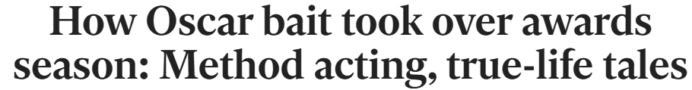
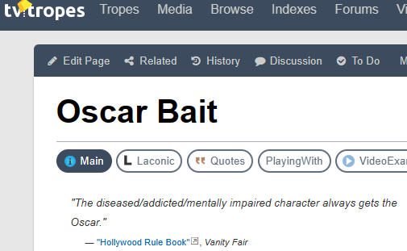
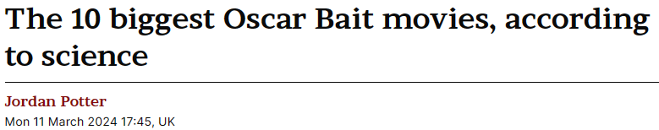
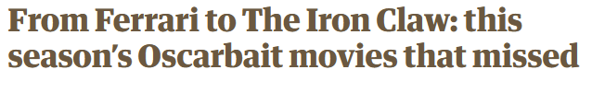
Do Movies with higher Box Office Revenue perform better at the Academy Awards?
Notes:
Now I don’t know if you were aware of this but the 96th Academy Awards, better known as the Oscars, took place on 10th March - just a couple of weeks ago. Of course, this dominated our conversation when we were working out a topic, when Athul posed the question *click* - Do Movies with higher Box Office Revenue perform better at the Academy Awards?
So we started looking into it, but as we sought out our initial data and did our preliminary research, one term kept coming up. *click until all headlines are visible, last one is centred and fades in*
“Oscar Bait” is a term that journalists love to use, describing movies released just before the awards season with the goal of picking up one of those prestigious trophies. But does that term carry weight? Does the idea of Oscar Bait create a bias amongst journalists with their reviews? Does it bring more people to the cinema? Do those “Oscar Bait” movies actually have more chance of picking up an award than movies released outside that October-December window?
Or, to simplify those questions into one overarching topic: *click to next slide*

Slide 2
Is ‘Oscar Bait’ real?
Team members:
Athul Madhusudhanan
Daniel Daniel
Essa Bostan
Mujahid Iqbal
James Hanson
Notes:
Is Oscar Bait Real? *Pause for a moment so people can read the team members names, then click to next slide*

Slide 3




What is it?
Films engineered to attract an Oscar nomination
Released shortly before the Oscar nominations close
Generally with a more serious tone
Enhance reputations of those involved
Notes:
First, we need to define what it is, so I did some reading, and found some main elements that describe it, and can help to shape the data we need and the hypotheses we will be testing. *click* These movies are engineered with the goal of being nominated for an Oscar. *click* They’re usually released within two months of the nominations closing at the end of the year. *click* They often have a more serious tone *click* and they are often made to enhance the reputations of those involved. Specifically, we’ll be focusing on those first two points, although with more time, we could have also looked at genres and actors/directors over a number of years for further research.

Slide 4


The Academy
The organisation that hosts and decides the Academy awards
Various actors, writers, producers, and other craftsmen
Notes:
The Academy
Who is the Academy?
The Academy of Motion Picture Arts and Sciences is the organisation that hosts and decides the Academy awards, colloquially known as the Oscars.
The Academy consists of various actors, writers, producers, and other craftsmen and members in the Hollywood and Film industry.
What do they do?
The Academy are the ones who vote for the films that are nominated at the Oscars. They also vote for the winners. Not the general public.
Membership
To be member of the Academy, you cannot apply for it, you must be sponsored by someone who already has membership, unless you are a previous winner or nominee.

Slide 5
Hypotheses
Question:
Are movies released within two months of the Academy Awards Nominations window more likely to be nominated for an award?
Hypothesis:
If a movie is released within two months of the nominations closing, it is more likely to be nominated
Question:
Do movie review scores accurately reflect how a movie will perform at the Academy Awards?
Hypothesis:
If a movie receives high review scores, it is more likely to be nominated
Question:
Do movies released within two months of the Academy Awards Nominations window receive higher review scores than movies released outside of that window?
Hypothesis:
The later in the year a movie is released, the higher average review scores it will receive.
Notes:
So what will we be testing? *click* Well firstly asked whether movies being released shortly before the Academy Awards are actually being nominated for more Academy Awards. We can assess this with a pie chart showing the proportion of movies nominated for an award that are within that period or not, with a bar chart to show changes by month, and with a line chart showing the trend over a number of years. *click* Secondly we wanted to know if Review scores accurately reflect how a movie will perform at the Academy Awards. We can assess this with a box plot showing the quartiles and average of review scores, and then overlay the nominated movies to show how they compare to the average movie for Review score. *click* Finally we wanted to know whether movies released in that two month period before the Academy Awards nominations window closes receive higher review scores. We could compare this against our findings for the other questions to answer whether journalists have a bias towards movies released later in the year which may fuel the idea of “Oscar Bait”. We will test this with a Scatter Plot with a Linear Regression line to show the trend of review scores through the year. Each question will have plots for 3 different years, so we can see whether there have been any changes to this trend over time, and take into account how external factors like Streaming may have impacted the Academy Awards.

Slide 6
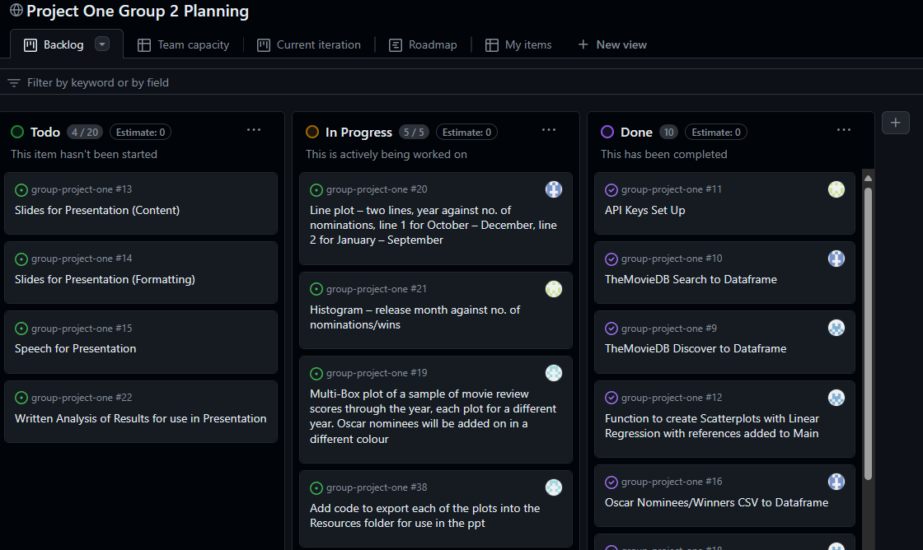
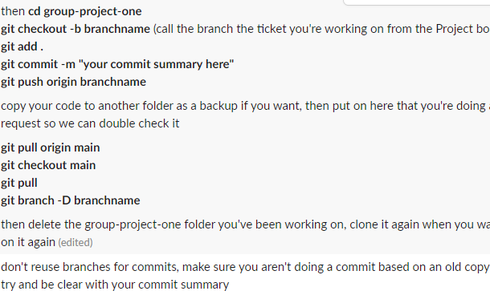
Team Collaboration
Agile Project Management
Establish commit policy
Notes:
We’ll keep this section quick, but this is how we collaborated as a team, we used a Slack group chat to keep in touch and help each other out. We also set up a project board on Github to break down tasks into more manageable tickets and avoid double handling of tasks. Finally we established a policy for commits. As we’re all very new to this way of working, a commit policy meant we were all on the same page, and any code could be checked by others in the group to avoid merging issues and bugs.

Slide 7
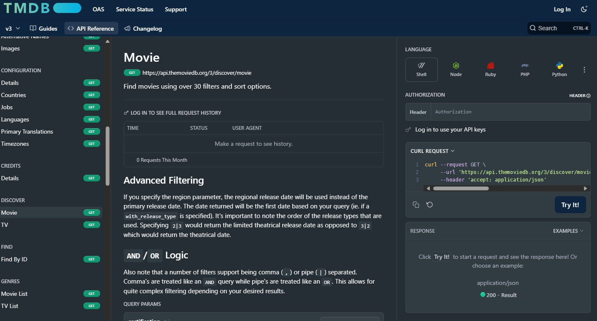
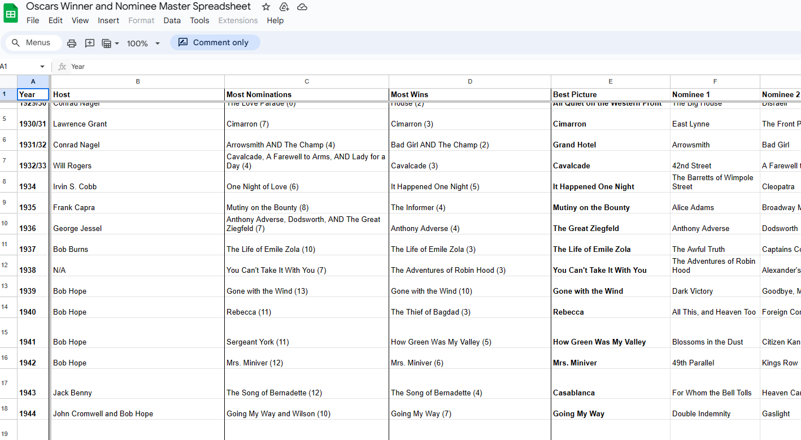
Data Sources
developer.themoviedb.org
Oscars Winner and Nominee Master Spreadsheet - Google Sheets
Notes:
To collect our data, we looked at several options, but settled on TheMovieDB’s exceptional developer API tools to extract movie information, release dates and review scores. For our purposes, we will be considering only the top 10% most reviewed movies from each year, which we have found allowed our visualisations to be more readable, whilst maintaining accuracy. We also found a publicly accessible list of Oscar Winners and Nominees on a Google Sheet, which we saved as a CSV and used to cross reference the information from the API and add whether it was nominated for an Oscar.

Slide 8
Limitations and other factors
Bias in the Academy
Film Content
Notes:
Limitations, factors, and other considerations
Film content – is there a correlation between winning and the content of the film? Do some genres receive more critical acclaim?
Does casting more well known actors draw in a larger audience?
American films? The Academy is an American establishment so is there some inherent bias on films that employ American ideals?

Slide 9
Header
Put image above, caption here
Put image above, caption here

Slide 10
Header
Put image above, caption here
Put image above, caption here

Slide 11
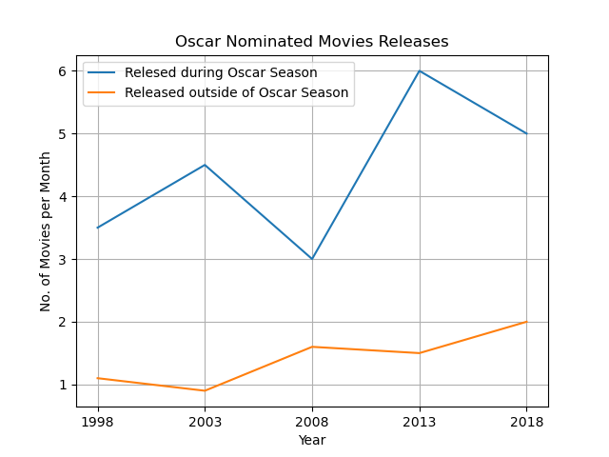
Multi-Line Plot
More nominated movies are released during “Oscar Season”
Strategic releases
Fresher in the minds of voters
Effect of streaming services?
Notes:
Multi Line Plot
Across all years tested, more nominated movies are released during “Oscar season”.
This is most likely due to the fact that these films are fresher in the mind of the Academy voters.
Limited and strategic releases may also be a factor; some films are shown exclusively to the academy before being opened up to a limited release right before Oscar Season.
Does streaming have an impact?
With the advent of streaming services like Netflix, Amazon Prime, Disney Plus etc., is there an impact on the number of people going out to see movies at the box office?
There has also been an increase of films released direct to streaming, completely bypassing the movie-going audience.

Slide 12
Conclusions
Put image above, caption here
Put image above, caption here

